Slide 1
Hunterdon County Vocational School District
Pre-Apprenticeship construction program
Edna Mahan correctional
facility for women

Slide 2
NJ Department of Labor & Workforce Development
NJ Build Incarcerated Women in Construction Grant
Promote pre-apprenticeship training in construction trades for incarcerated women at Edna Mahan Correctional Facility for Women.
Provide skills in various construction occupations along with workforce readiness.

Slide 3
Edna Mahan Correctional Facility for Women
Women's Correctional Faculty for women 16 and older located in Clinton, New Jersey.
Acting Commissioner is Marcus O. Hicks.
Holds up to 1000 inmates in maximum, medium and minimum security sections.
Participates in the "Puppies Behind Bars Program" allowing inmates to train guide dogs and is a registered apprenticeship program as Dog Handler.
Registered apprenticeship program for Administrative Assistant.

Slide 4
Training Summary
(2) 100-hour Intro to Construction & OSHA-10
(3) 60-hour Forklift & OSHA-30
(2) 100-hour Advanced Construction & OSHA-30
-Pre & Post TABE (Test of Adult Basic Education)
-Pre-screening – eligible for parole within 1-2 years.
-Team Building Activities.
-Work Readiness.
-Guest Speakers (Unions, Community Advocates, and Employers).

Slide 5
2018-2019 Cost
Administration $38,000
Instructors $70,000
Equipment (forklift simulators) $183,000
Instructional Supplies $5,800
Tools for participants $2,000
Training Books $1,200

Slide 6
Challenges: Security
Everything has to be cleared by security
Clearance to come and go at facility can be difficult, including restrictions on colors of clothing.
Establish classroom rules.
Security officer and body scanner placed outside classroom.
Security camera inside classroom.
Develop good working relationship with security officers.

Slide 7
Challenges: Tools & Supplies
Everything that comes in has to come back out
Allow sufficient time for DOC approval of materials and supplies before bringing to facility.
Have adequate and secure storage for tools & supplies.
15% of time spent checking out/in of tools and supplies.
No technology access. Training materials on flash drive.

Slide 8
Instructor Characteristics:
Flexibility: Prisons are places of routine disruption.
Boundaries: Develop a rapport, but it stays within the curriculum, never personal.
Good sense of humor.
Motivational: Ability to keep participants interested in the program.

Slide 9
2018-2019 Performance

Slide 10
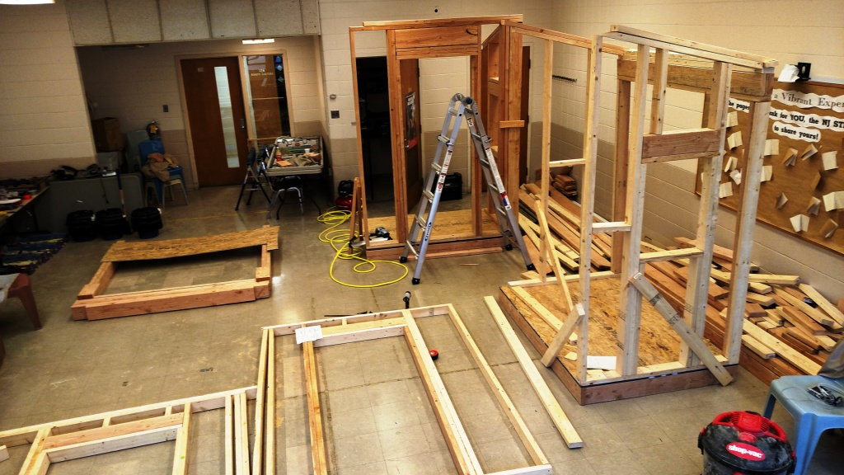

Slide 11
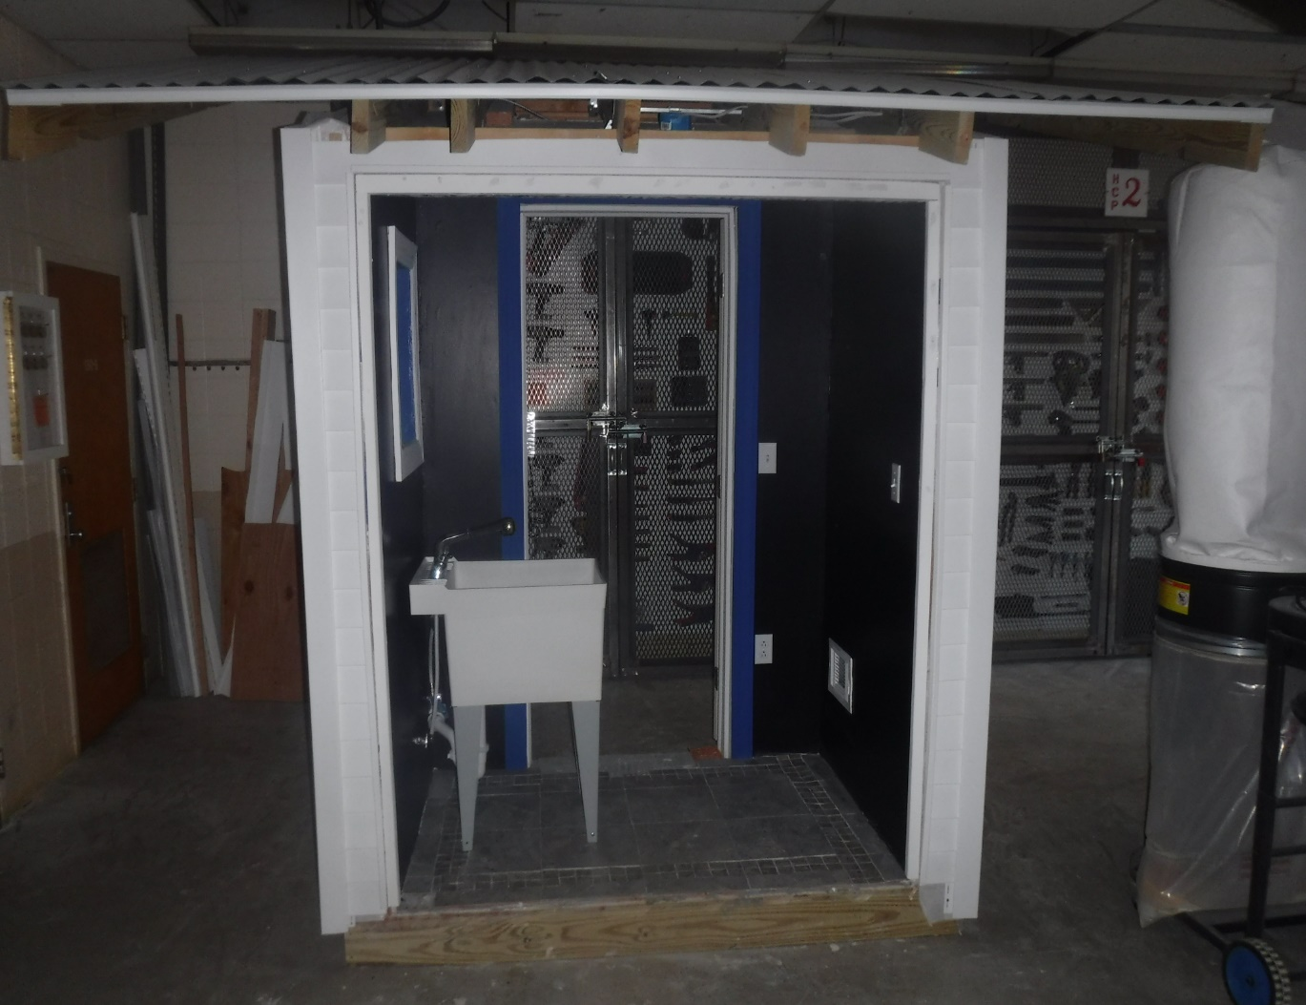
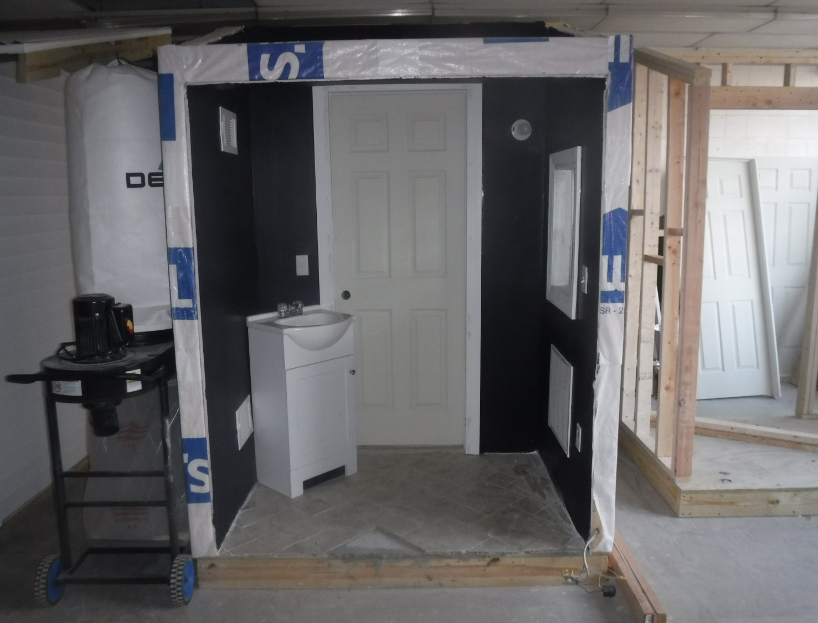

Slide 12
Contact Information:
Christina Shockley
Hunterdon County Vocational School District
Flemington, New Jersey 08822
cshockley@hcvsd.org

