Slide 1
Maine Department of Corrections
Correctional Facilities
Maine State Prison
Bolduc Correctional Facility
Maine Correctional Center
Mountain View
Down East Correctional Facility
Long Creek
Woman’s Reentry Center

Slide 2
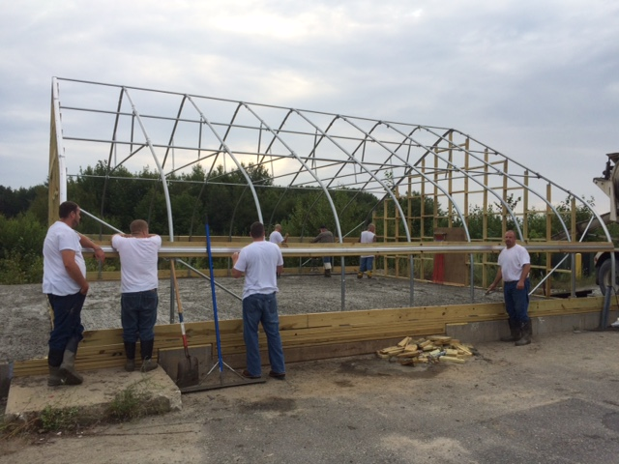
MDOC Apprenticeship Program
Program Goals
1. Provide Marketable Skills to Offenders
2. Leverage Regional Industry Stakeholders
3. Form Lasting Stakeholder Partnerships
4. Provide Skilled Work Force for the State
5. Enhance Transition Success
6. Purpose Driven Incarceration

Slide 3
Service K-9 Trainer
Partnered with America’s Vet Dogs
Seven Primary and Secondary Handlers
Located in the MSP Veterans Pod
Fourteen Months of Intensive Training
2,000 Apprenticeship Hours
K-9s Trained to Service as Veteran Service Dogs

Slide 4
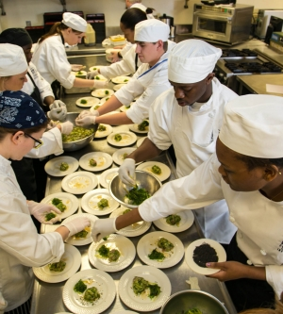
Hospitality Program
Offered at the MVCF and SMWRC
In Response to Significant Hospitality Opportunity and Industry Need
Two Certified Chef Instructors
Serve Safe Certifications
Apprenticeship Through Hospitality Maine

Slide 5
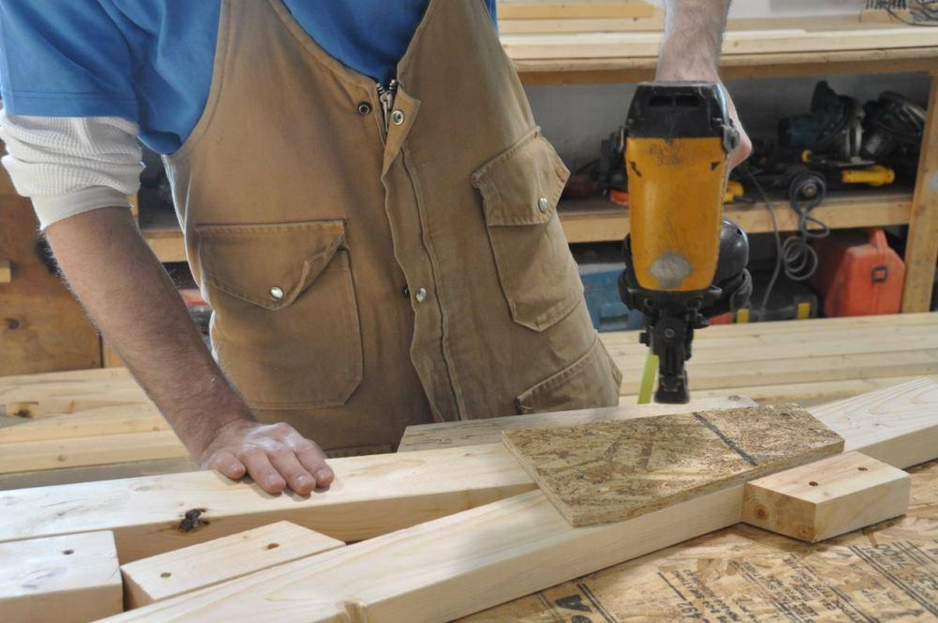
Carpentry Apprenticeship Program
Offered at Mountain View Correctional
NCCER Certification
Certified on Tools, Power Equipment
Practical Skills in the Community, Facility
Benefits Offender and Non Profits

Slide 6
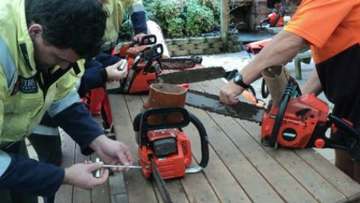
Certified Wood Harvester Program
Partnership with the Professional Wood Harvesters
Learn Heavy Equipment Operations, Chain Saw Safety, Forrest Management, Business, Legal Aspects of Timber Harvesting.
Manage 7,000 Acres of State Land in Cooperation with the Department of Inland Fisheries.
Harvest 1,000 Cords of Wood for Facility Heat

Slide 7
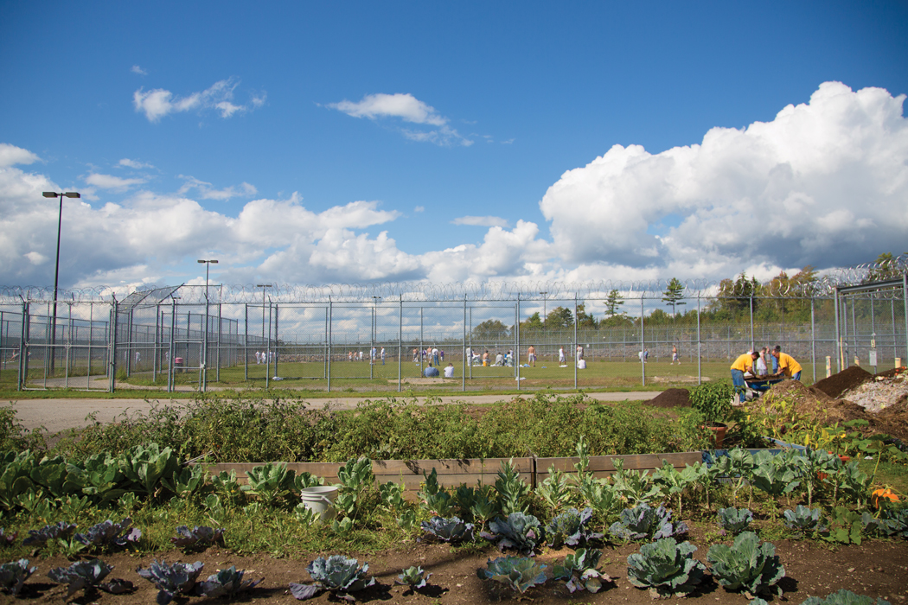
Sustainable Agriculture Program
Program Goals
● Teach Sustainable Agricultural Practices to Inmates.
● Provide Low Cost Vegetables to Offenders.
● Change the Prison Culture Through Self-Esteem Building in the Self-Raised Food.
● Mentorships Through Community Partnerships.

Slide 8
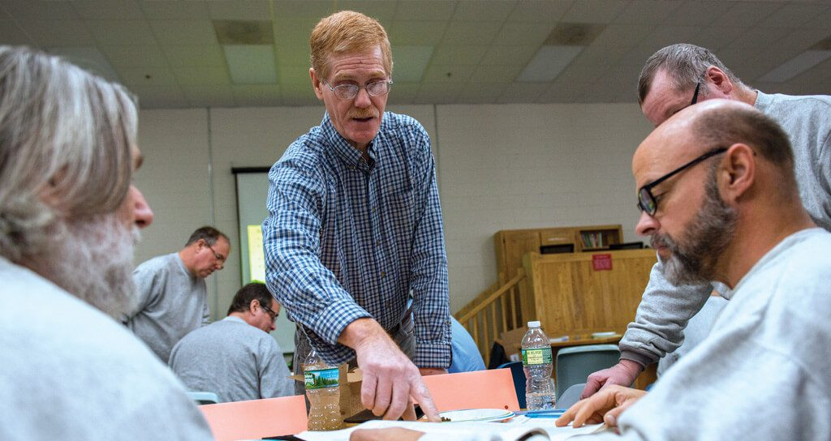
Building Partnerships
University of Maine, Cooperative Extension
Provided Weekly Crop Evaluation and Guidance.
Master Gardener Program, Twenty-Five Inmates Certified in the 40 Hour Program.
Inmates Learned Topics including; Soils, Composting, Botany,Vegetables, Pest Control, Crop Rotation and Green House Operations.

Slide 9
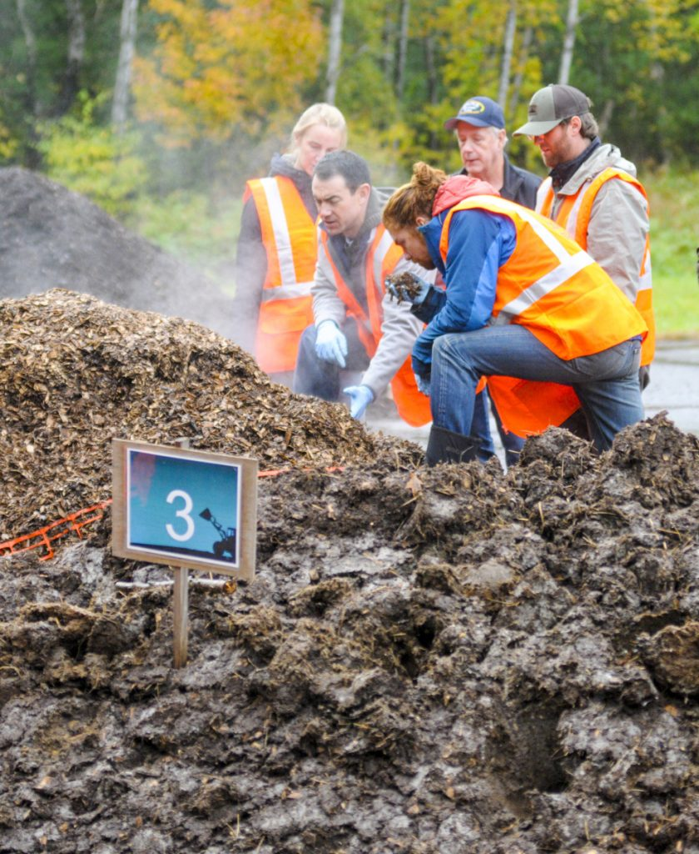
Maine Compost School
Certified Twelve Inmates as Compost School Graduates.
Three-Day Course in Basics of Composting.
In 2018, Inmates Composted 600,000 Pounds of Organics at the Maine State Prison. Saving $100,000 in Waste Removal. Compost was Rotated into the Gardens.

Slide 10
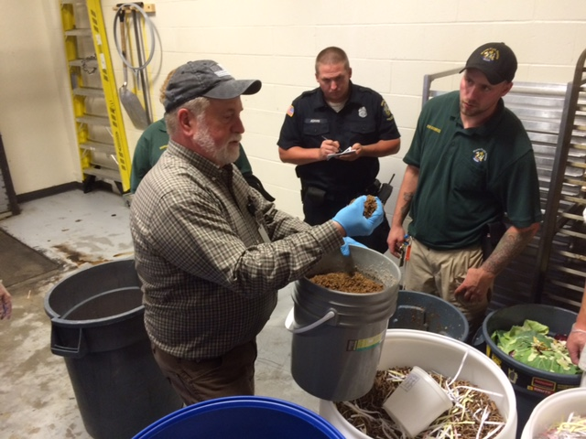
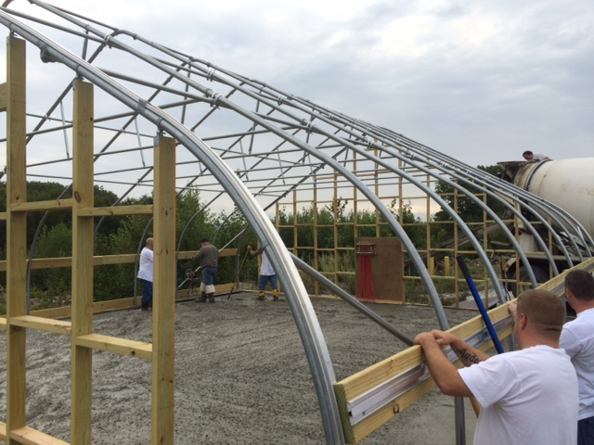
Master Farmer Mark McBrine

Slide 11
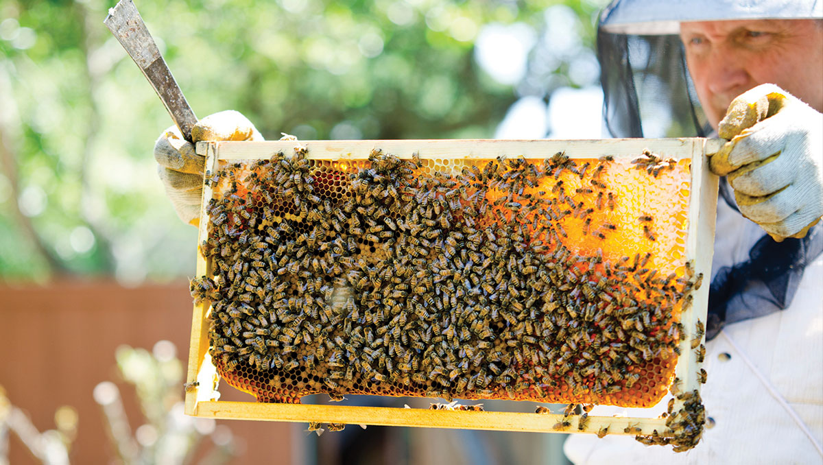
Master Bee Keeper Walter Keisow
Partnered With Volunteer Master Bee Keeper
For Five Bee-Keeping Courses.
Certified Forty-Five Inmates in Bee-Keeping.
Inmates Built Three Hives in the Wood Shop and in 2018, produced One Hundred Sixty pounds of Honey on the Prison Grounds.

